Slide 1
HOLY GUACAMOLE
Notes:
Heidi - Welcome to Entity Academy ! Today Monica and Heidi are presenting to you a little information about avocado consumption in 3 different regions of the USA . There may just be a little surprise ahead about this little green fruit of goodness and the place it is liked best. But first let’s get acquainted with the two speakers of the day, Heid and Monica.

Slide 2
Personal Information Examples
Major Biology/Chemistry
Orientation Trainer
Trainer on Compliance and Policy
Military Officer
Name
Location
Notes:
Monica - I am Monica Moore a graduate of Rust College which is located in Holly Springs , MS. Currently I am an Orientation Trainer teaching company policy and procedures to new hires. I am a commissioned reserves officer through Memphis State University, with 12 years having served in the quartermaster corp and medical service corp. I am looking forward to graduating from Entity with continuously educating myself in the AI, Robotics and Blockchain sectors. I am looking forward to becoming an asset to many teams.

Slide 3

CONTENTS
01 Data Collection
02 Data Wrangling
03 Exploration
04 ANOVAs
05 Logistic Regression
Notes:
Heidi

Slide 4
Avocado Consumption
Comparing Prices and Volume of Avocados in three different US Regions
Buffalo/Rochester, NY
Dallas/Ft Worth, TX
San Diego, CA
Notes:
Heidi - Although there are many regions presented in the available data frame, only 3 were chosen. These regions form a triangle on the map with the Northern tip representing Buffalo/Rochester, NY ( How about those Bills though?). In the right corner, wearing a 10 gal hat, we are looking at Dallas/Ft.Worth and in the left corner producing the most avocados in the USA, Saaaan Dieeego!

Slide 5
Methods - Data Collection
Downloaded from the Woz-U Github repo
CSV file
Imported using Pandas library
Original source is from Kaggle
Notes:
Heidi - the original source of the data set is Kaggle. However, the dataset used ,was downloaded from the Woz-U github repo as a CVS file.
DONE

Slide 6
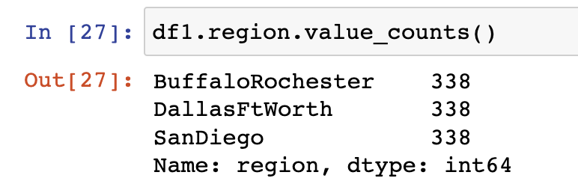
Data Wrangling
Original dataset contained 18249 rows
Dataset includes 54 regions
Over 4 years (2015, 2016, 2017, 2018)
A subset of the three regions was used in this analysis
Sample sizes were the same for each region (338)
Notes:
Heidi - As shown here there are 18249 rows and 54 regions in the original dataset. In order to go through all of those, we will have to order some pizzas and get comfy because it would take quite a while. Since everyone, I am supposing, wants to go home tonight, the information was condensed to 3 equal sample sizes of 338 and the information runs the course of 4 years.

Slide 7
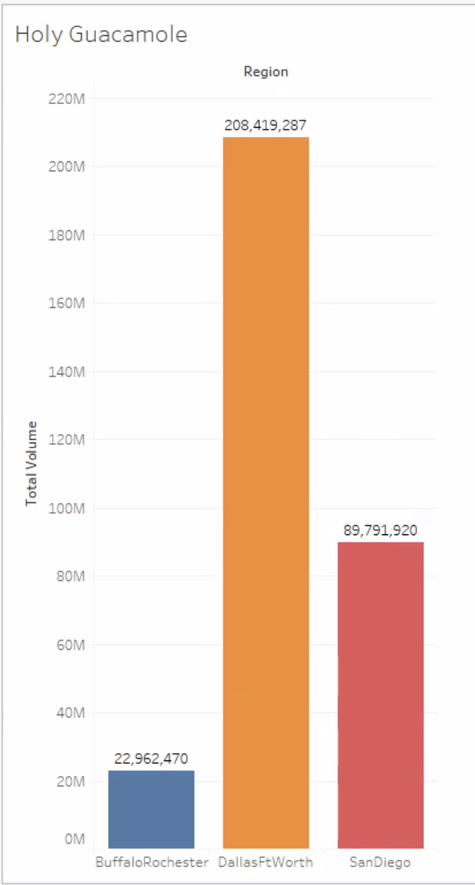
Avocado Consumption per Region
Notes:
Heidi- No that is just purdy! Here it is clearly visible that Dallas/Ft Worth has the tallest skyscrapers. Ok, Not really. What is shown here is the consumption of avocados by region. Yeehaw and Holy Guacamole to Dallas/Ft Worth with the highest consumption. Although as earlier mentioned, San Diego may produce most of the avocados in the US, they only eat around half of the amount Dallas/Ft Worth does. I am wondering here, if San Diego just loves to grow avocados just to send them to Dallas/Ft Worth to be eaten. Buffalo/Rochester comes in 3rd with plenty of wiggle room for improvement in consumption.

Slide 8
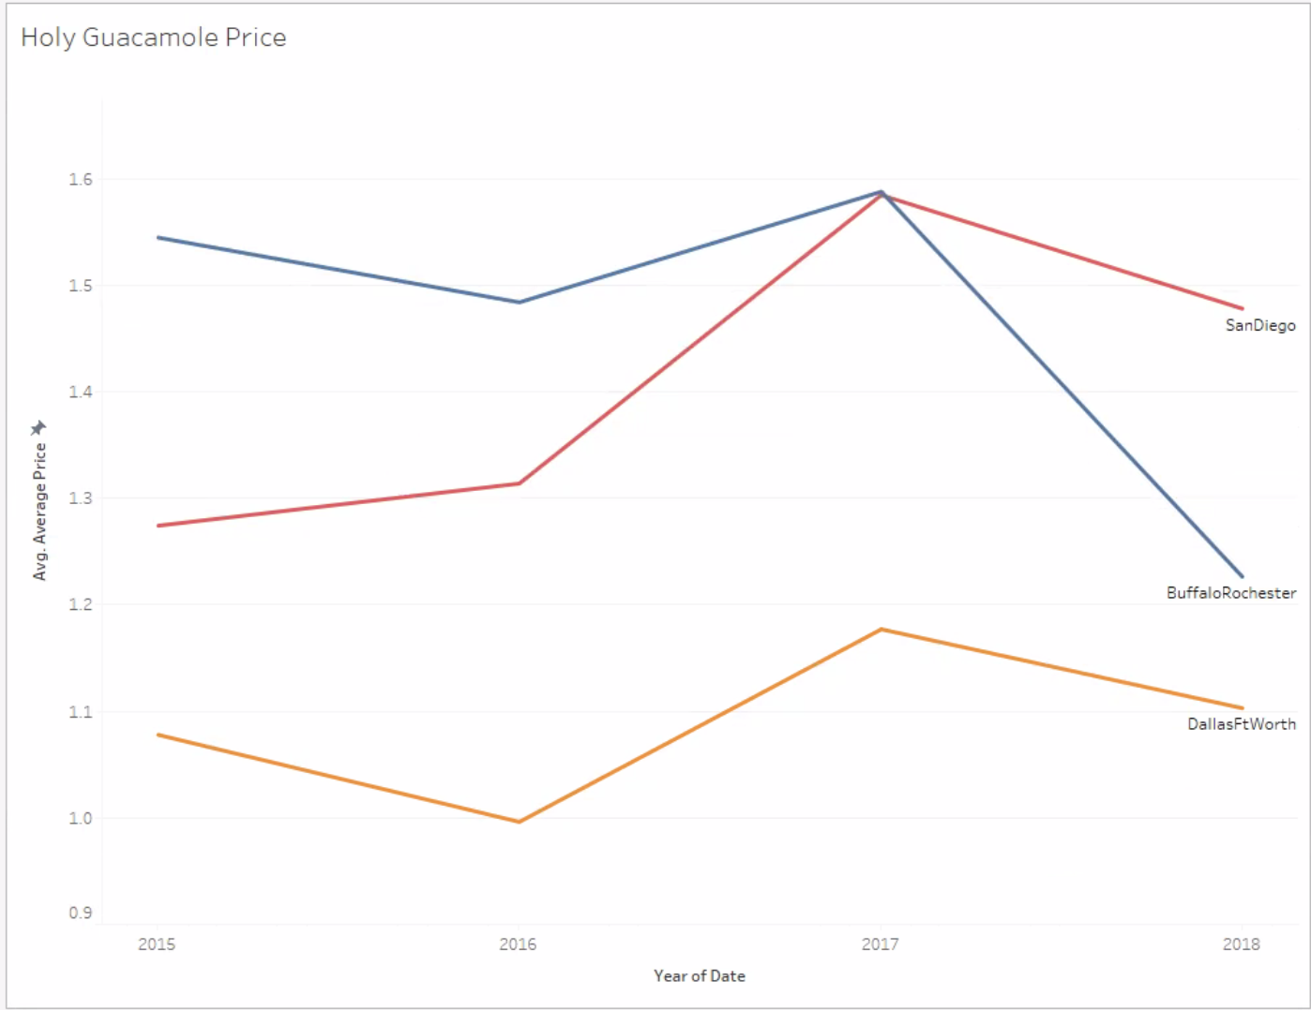
Avocado Price Over Time
Average Avocado Price of all 54 regions and all 4 years was $1.41
Notes:
Heidi- Buffalo/Rochester had the highest prices (Disregard 2018, the data is incomplete for that year). There was an increase of about 30 cents for the average avocado in San Diego from 2015-2017. Dallas/Ft. Worth had the lowest prices and highest volume of Avocados consumed.

Slide 9
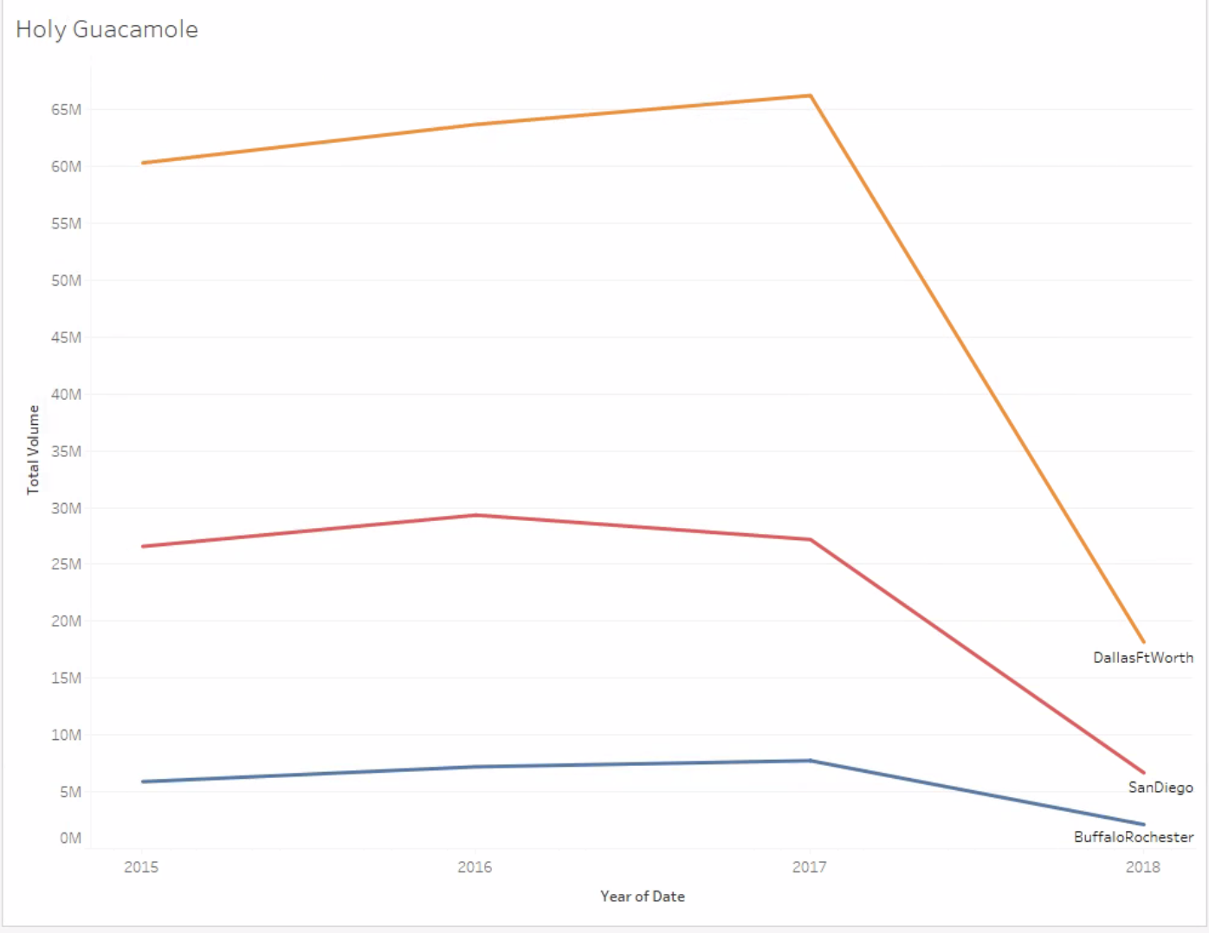
Avocado Consumption Over Time
Notes:
Heidi - Avocado consumption did not change much from 2015-2017. The reason for the decrease in 2018 is because the data only went to March.

Slide 10
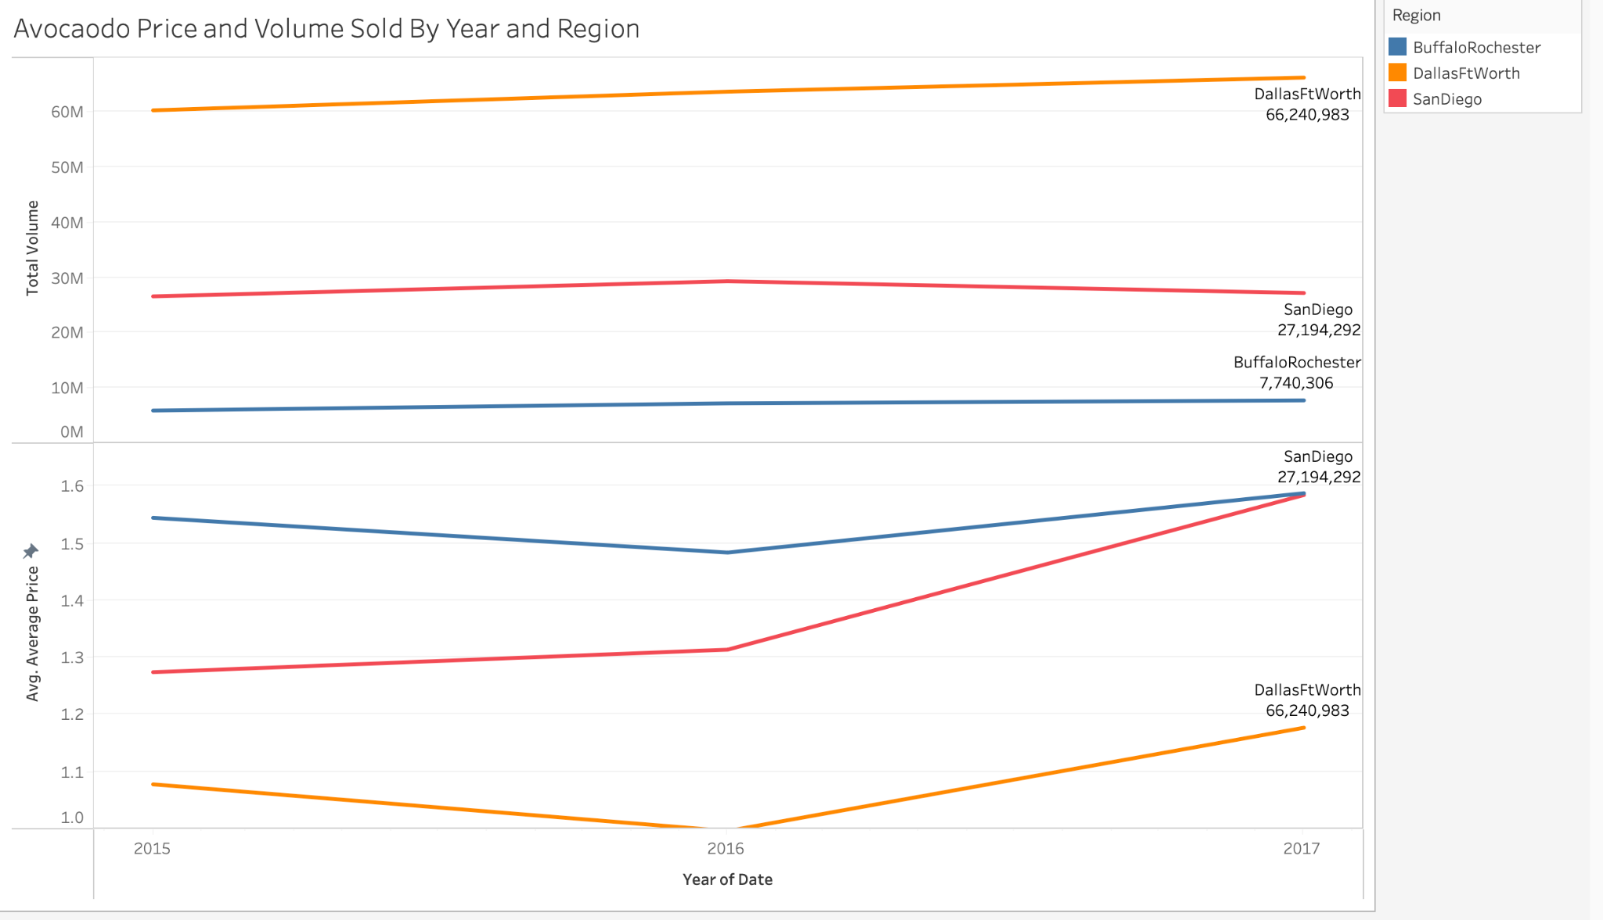
Data Exploration
Notes:
Patricia - Total Volume did not change much from 2015-2017. Average price increased from 2015-2017 with San Diego being the highest spike. Buffalo had the highest average price around $1.48 and $1.58 per avocado.

Slide 11
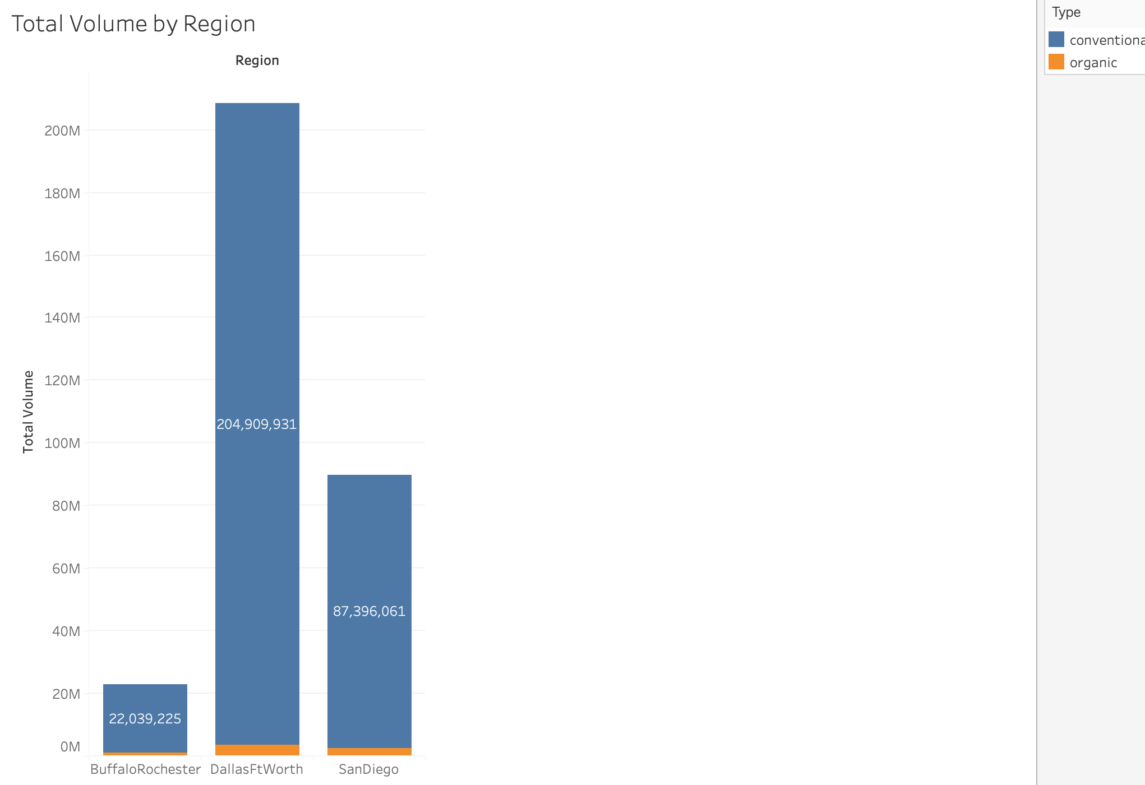
Data Exploration
Notes:
Patricia - As you can see, there was a significantly more non-organic avocados bought than organic. Organic avocados sold is the orange section of the bar chart. Dallas Ft. Worth sold the most avocados with about 205 million. San Diego sold 87 million and Buffalo/Rochester sold 22 million from 2015-2017.

Slide 12
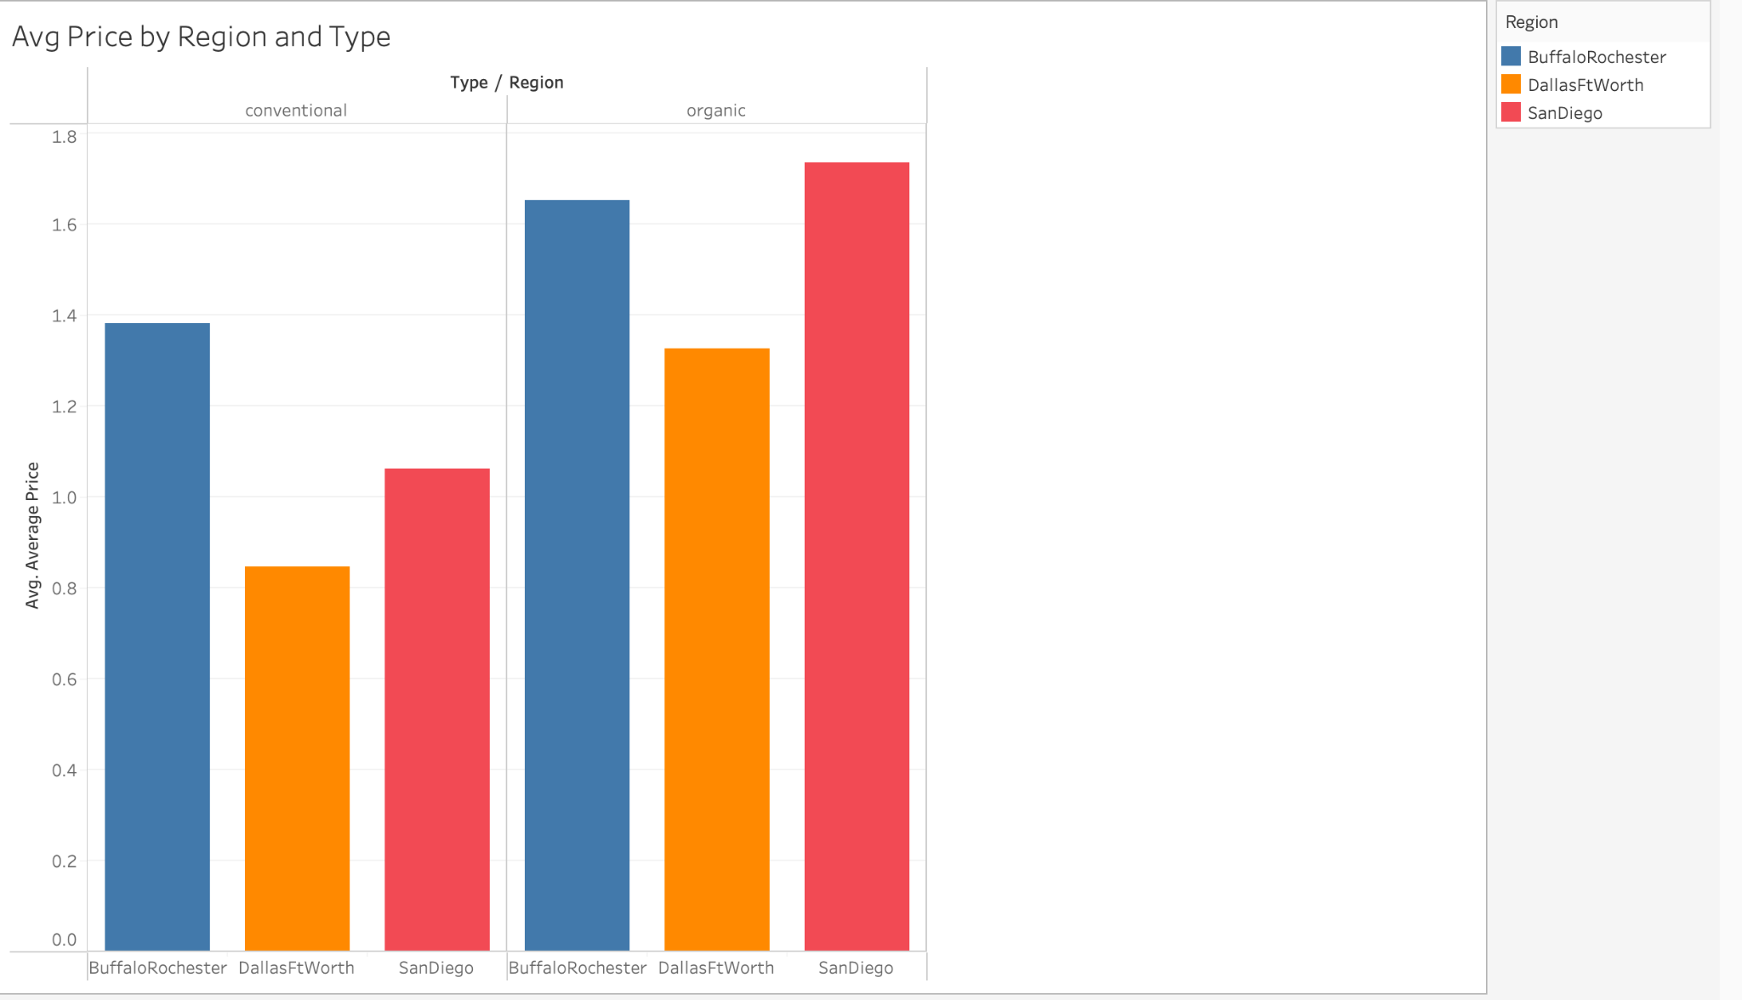
Data Exploration
Notes:
Patricia - Organic prices are higher in each region. Dallas Ft. had lowest average price for both types. San Diego had the highest organic price and Buffalo/Rochester had the highest non-organic price.

Slide 13
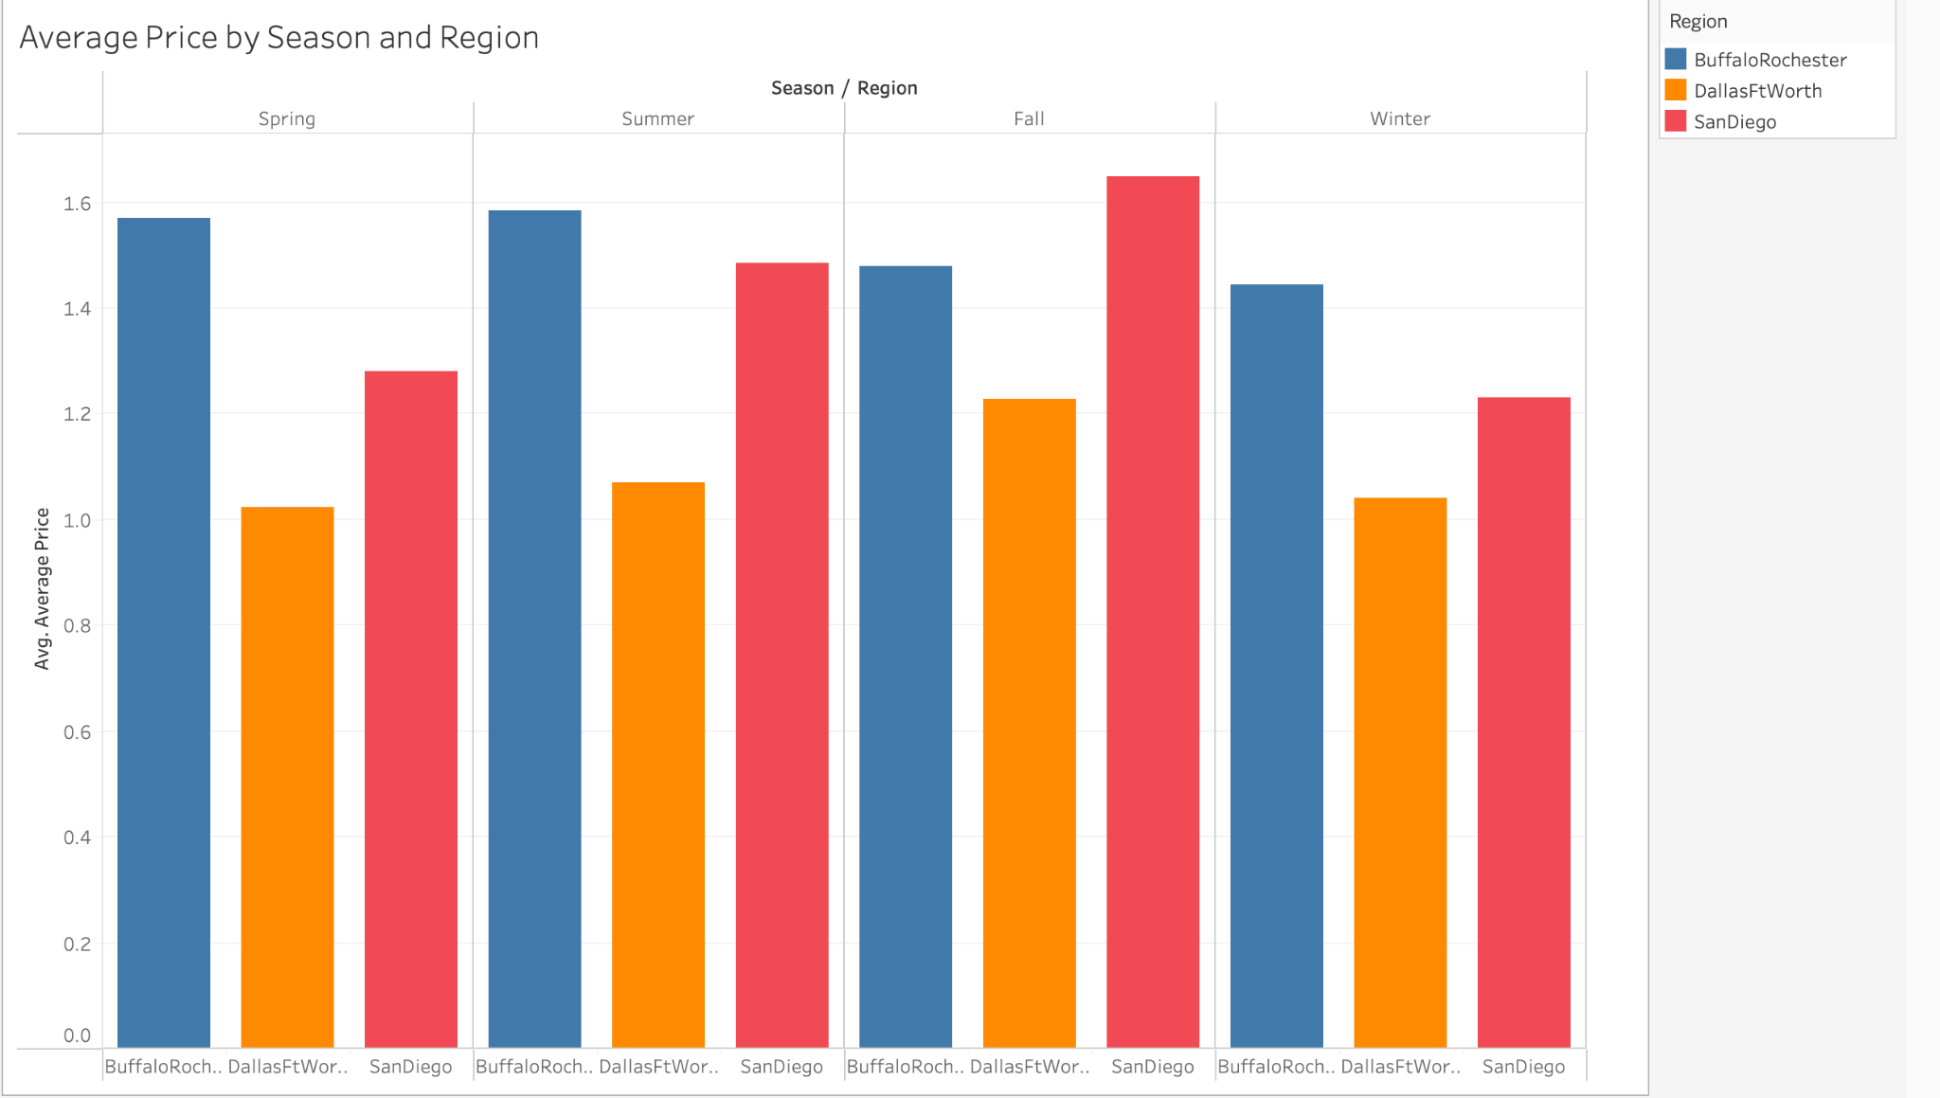
Data Exploration
Notes:
Patricia - Prices were higher in the Fall for Dallas/Ft. Worth and San Diego. Prices did not change much per season in Buffalo/Rochester area. The average price stayed the same for Spring and Summer in Buffalo/Rochester.

Slide 14
Were the average avocado prices different between the regions?
Notes:
Monica

Slide 15
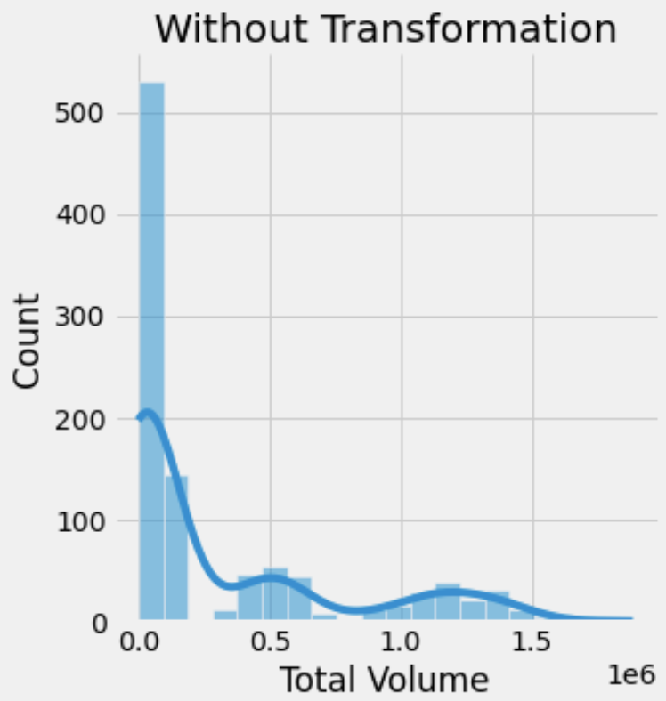
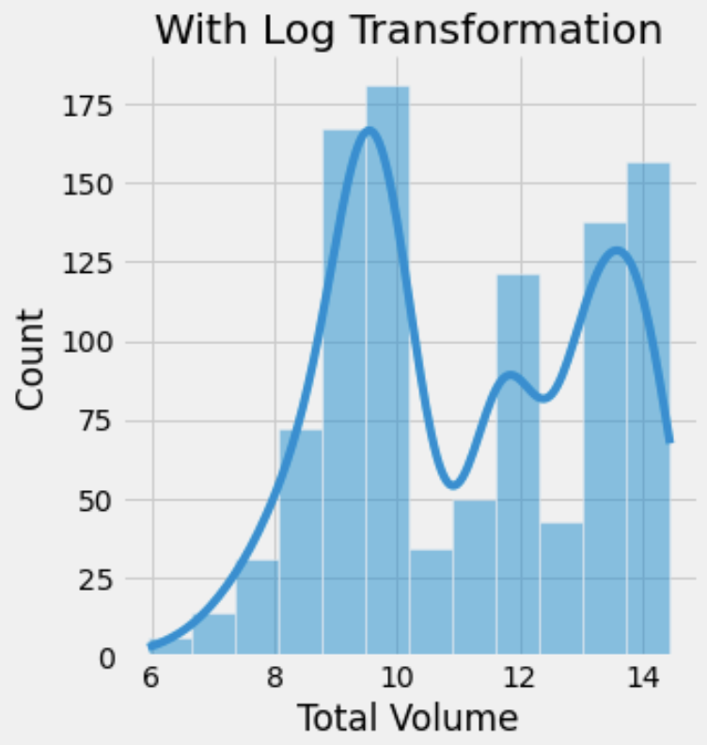
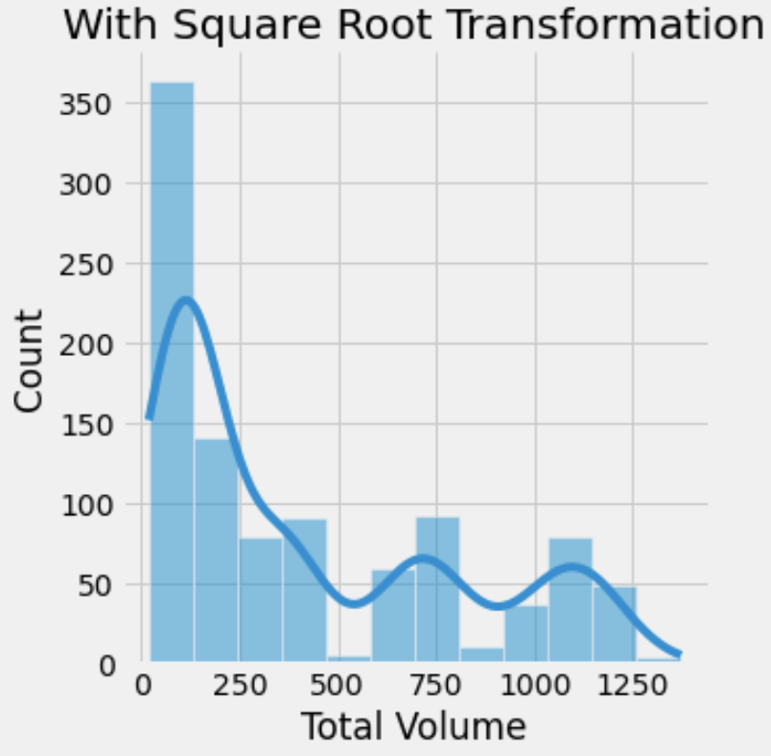
One-Way ANOVA
ANOVA Assumption of Normality
Log Transformation seems to normalize the most.
Notes:
Monica - Now we will look at our Anova. We started with a Log transformation to normalize the dependent variable.

Slide 16
One-Way ANOVA
ANOVA Assumption of Normality - CONT
However, a Bartlett’s Test result is significant and the homogeneity of variance has been violated. We will continue anyway but be wary of our results.
Notes:
Monica - However, a Bartlett’s Test result is significant and the homogeneity of variance has been violated. We will continue anyway but be wary of our results.

Slide 17
One-Way ANOVA
ANOVA Assumptions
Sample size has a least 20 cases per independent variable
No overlap between groups (regions) and region testings are not related
Sphericity is not applicable because it’s not a between subjects design
Notes:
Monica - We pass the other ANOVA assumptions. The independent variable sample size has a least 20 cases. There is no overlap between regions and we can disregard sphericity.

Slide 18
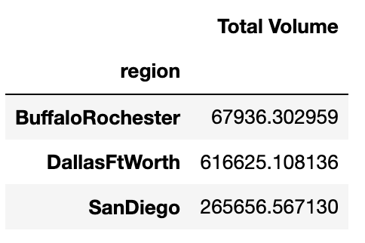
One-Way ANOVA Comparing Region and Volume Sold
ANOVA Results
ANOVA result was significant serving as evidence that there was a difference between average avocado consumption (volume sold) of the three regions
There was also a significant difference in consumption BETWEEN each region
Notes:
Monica- ANOVA result was significant serving as evidence that there was a difference between average avocado consumption (volume sold) of the three regions. The average volume was the lowest in Buffalo/Rochester and the most in Dallas/Fort Worth. However, since we did not pass the assumption of equal variances, we will be suspect of our results.

Slide 19
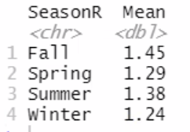
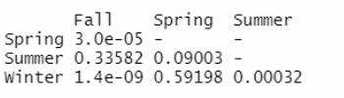
One-Way ANOVA Comparing Season and Price
ANOVA Results
Assumption of normality was met
Homogenity of Variance was violated, so made corrections using R software
ANOVA was significant serving as evidence prices differ per season
Notes:
Anna Green - Now we will share the results of an ANOVA that tests difference in Price depending on season. The normality assumption was not violated. Correction for the violation of homogeneity of variance was made using R software. The ANOVA result was significant serving as evidence prices differ per season. Fall has the highest, and winter has the lowest. The biggest difference is between Fall and winter.

Slide 20
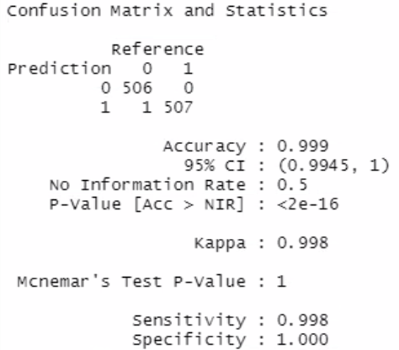
Predicting Organic or Non-Organic with Logistic Regression
Logistic Regression Results
The model resulted in 99% accuracy.
There was only one false-positive resulting in a sensitivity of 99.8%.
The average price of organic avocados was $1.57.
The median price of organic avocados was $1.52.
The average price of conventional avocados was $1.10.
The median price of conventional avocados was $1.07.
Notes:
Julie W - These are the results of Predicting Organic or Non-Organic with Logistic Regression. The model resulted in 99% accuracy. There was only one false-positive resulting in a sensitivity of 99.8%. The average price of organic avocados was $1.57. The median price of organic avocados was $1.52. The average price of conventional avocados was $1.10.The median price of conventional avocados was $1.07. However, when testing assumptions, the logit was not linear so the results are suspect.

Slide 21
THANK YOU
Notes:
Thank You

